Slide 1
SECURE DATA HIDING IN IMAGES USING STEGANOGRAPHY
CAPSTONE PROJECT
Presented By:
Student Name : SANTHOSH KUMAR PETCHIMUTHU
College Name & Department : GOVERNMENT COLLEGE OF ENGINEERING,ERODE.
B.TECH INFORMATION TECHNOLOGY.

Slide 2
OUTLINE
Problem Statement
Technology used
Wow factor
End users
Result
Conclusion
Git-hub Link
Future scope

Slide 3
Problem Statement
Traditional encryption methods can attract attackers, making secure communication challenging. Steganography allows data to be hidden in images, but existing techniques face issues like low capacity and vulnerability to detection. Maintaining image quality while ensuring secure and undetectable data embedding is a key challenge. This project aims to develop a robust steganographic method with high security, minimal distortion, and strong resistance to attacks. The goal is to enhance data-hiding efficiency while ensuring safe and reliable retrieval.

Slide 4
Technology used
Software Requirements
Operating System: Windows, Linux, or macOS.
Development Environment: VS Code (Visual Studio Code).
Hardware Requirements:
RAM: Minimum of 8 GB required for smooth execution.
Graphics Card: Intel Iris Xe Graphics or better.
Storage: At least 512 GB of available disk space.
Programming Languages:
Python 3.6 or Higher.
OpenCV (cv2) –for image processing.
Tkinter – for GUI development.
OS – for handling file paths.
String – for text processing.

Slide 5
Wow factors
Unique Features of Secure Data Hiding in Images Using Steganography
Dual-Layer Security – Combines LSB steganography with password-based encryption for enhanced protection.
User-Friendly GUI – Intuitive Tkinter interface with separate encryption and decryption sections.
Optimized Performance – Uses OpenCV for fast, efficient image processing with minimal distortion.
Cross-Platform & Scalable – Runs on Windows, Linux, macOS, and can be extended to support audio and video steganography.

Slide 6
End users
Journalists & Whistleblowers – Securely transmit sensitive information without detection.
Government & Intelligence Agencies – Protect confidential communications from cyber threats.
Corporate & Cybersecurity Professionals – Safeguard trade secrets and internal documents.
General Users & Privacy Enthusiasts – Ensure personal data privacy in digital communications.

Slide 7
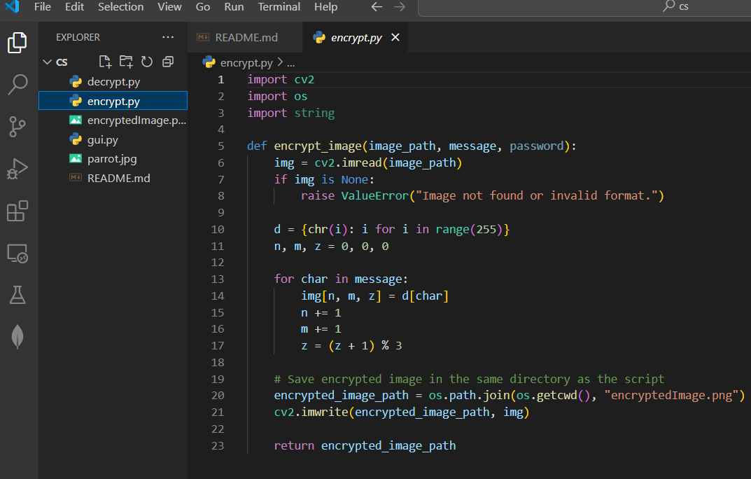
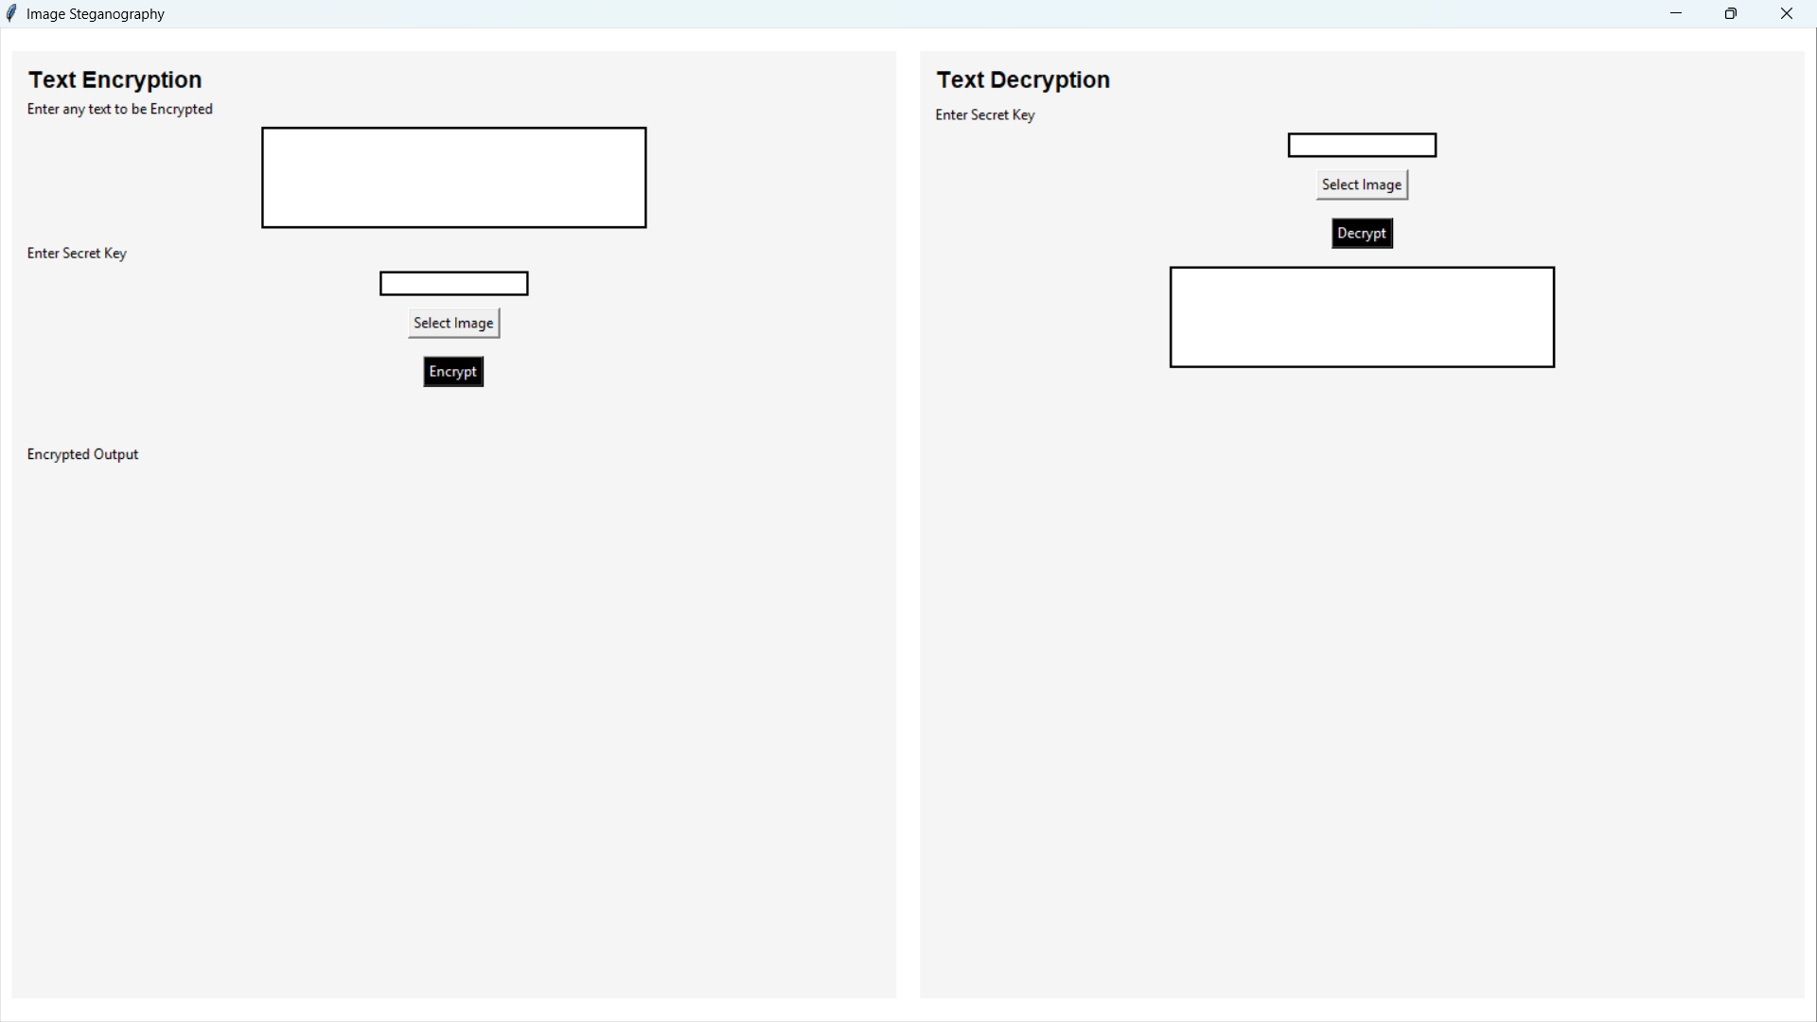
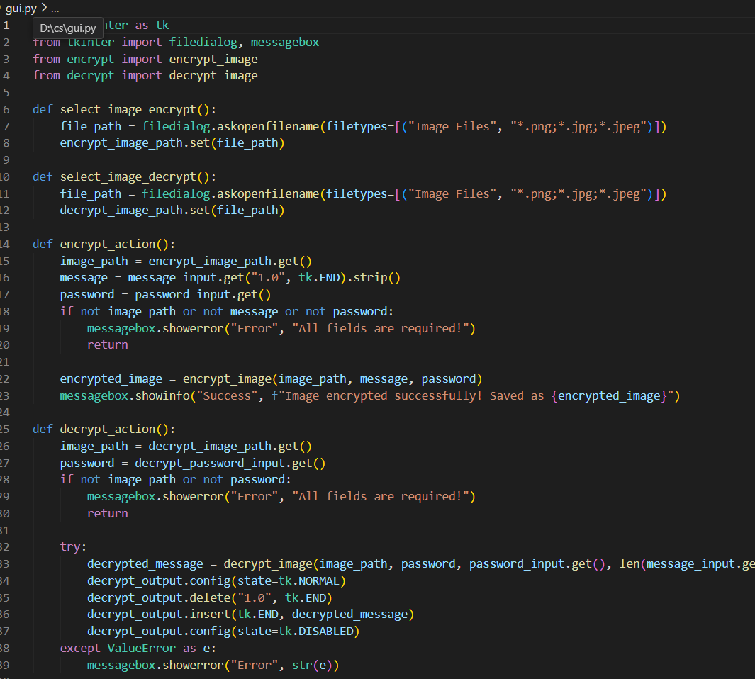
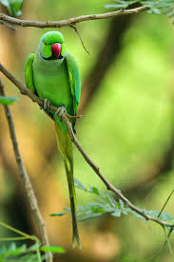

Results

Slide 8
Conclusion
This project effectively addresses the challenge of secure data transmission by leveraging LSB steganography to hide sensitive information within images. By integrating a user-friendly GUI, AES encryption, and password protection, it ensures confidentiality, integrity, and accessibility. The project stands out with its enhanced security measures, ease of use, and cross-platform compatibility, making it a reliable solution for secure communication.

Slide 9
GitHub Link
https://github.com/SANTHOSHPETCHIMUTHU/SECURE-DATA-HIDING-IN-IMAGES-USING-STEGANOGRAPHY.git

Slide 10
Future scope(optional)
Enhanced Security – Implement AES/RSA encryption for stronger protection of hidden messages and use hashing algorithms to verify message integrity.
Support for More Formats – Extend compatibility to BMP, TIFF, MP3, and MP4 for better quality and introduce audio/video steganography.
AI-Powered Steganography – Use machine learning to optimize pixel selection for hiding data, making detection harder and improving efficiency.
Mobile & Web Integration – Develop an Android/iOS app and a web-based tool to allow users to securely hide and retrieve messages from anywhere.

Slide 11
THANK YOU

